Slide 1
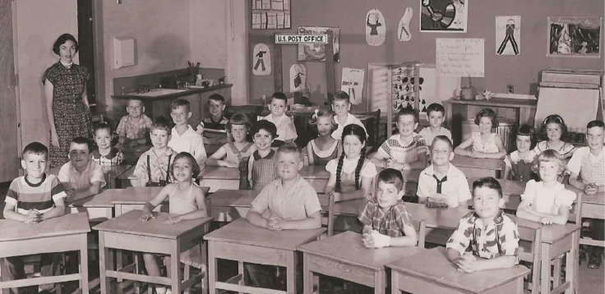
Desegregation at Abingdon Elementary

Slide 2
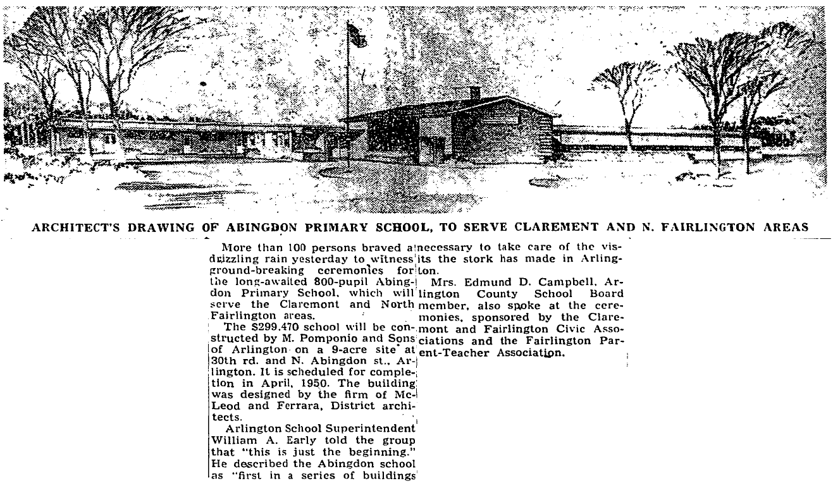
1950 – Abingdon Opened

Slide 3
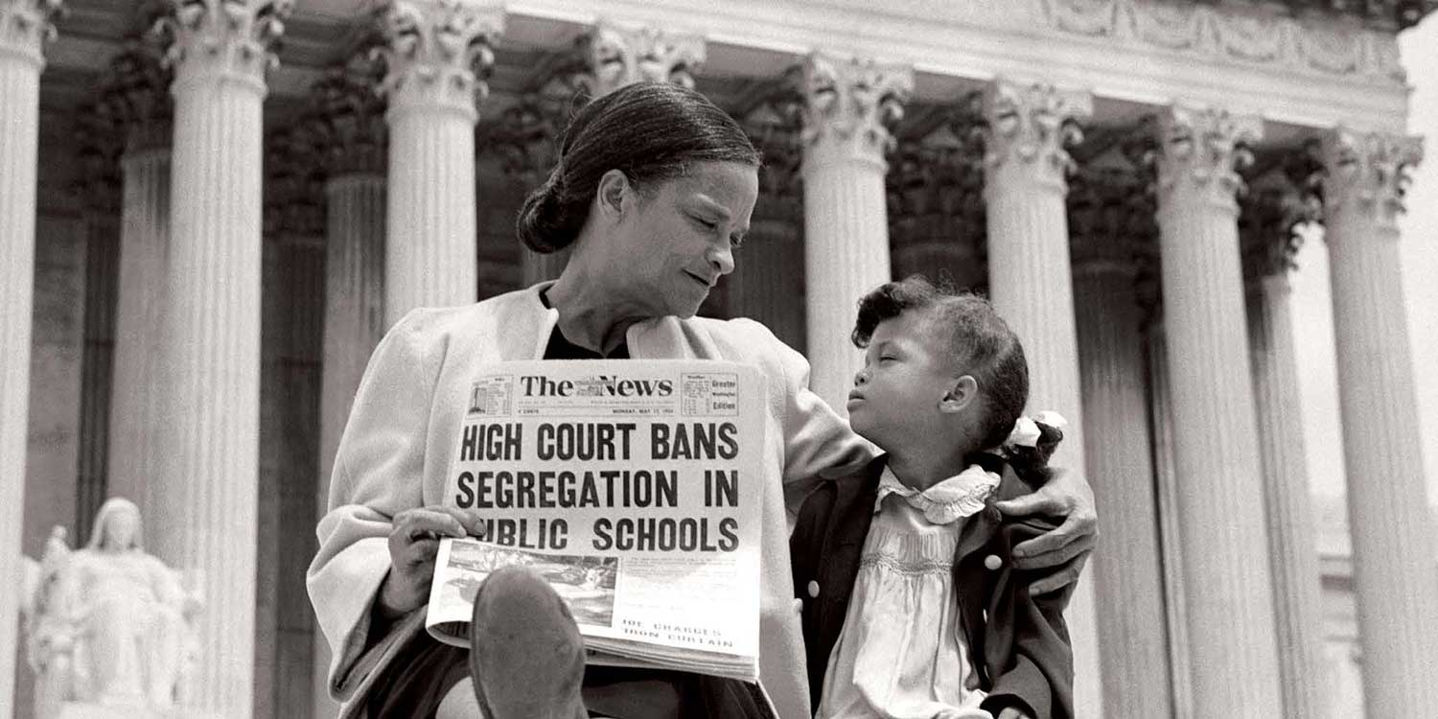
1954 – Brown v Board of Education

Slide 4
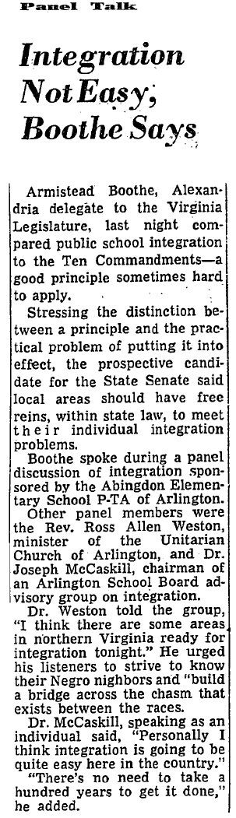
1955— Abingdon PTA Discussion Panel
"...a good principle sometimes hard to apply..."
"...there are some areas ready for integration tonight."
"...build a bridge across the chasm that exists between the races."
"I think integration is going to be quite easy here in the country.... There's no need to take a hundred years to get it done."

Slide 5
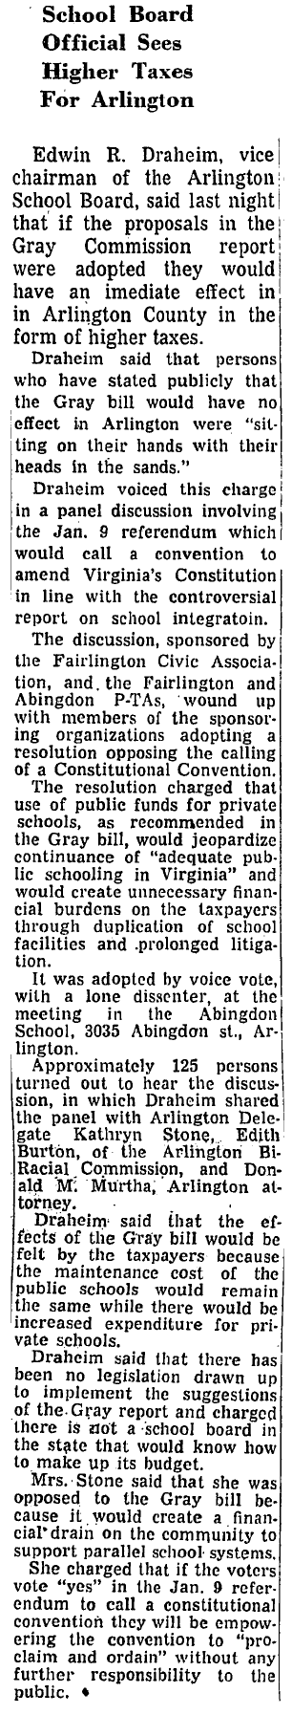
1955 – PTA Vote Opposing Massive Resistance
"The discussion, sponsored by the Fairlington Civic Association and the Fairlington and Abingdon PTA's, wound up ... adopting a resolution opposing the calling of a Constitutional Convention [which was intended to support public financing for private schools in which segregation would be permitted].
"It was adopted by voice vote, with a lone dissenter, at the meeting in the Abingdon School, 3035 Abingdon St., Arlington."

Slide 6
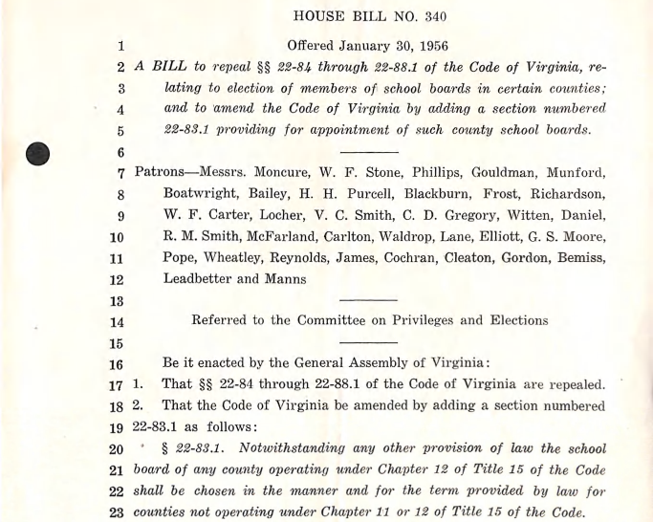
1956 – Arlington's School Board Replaced

Slide 7
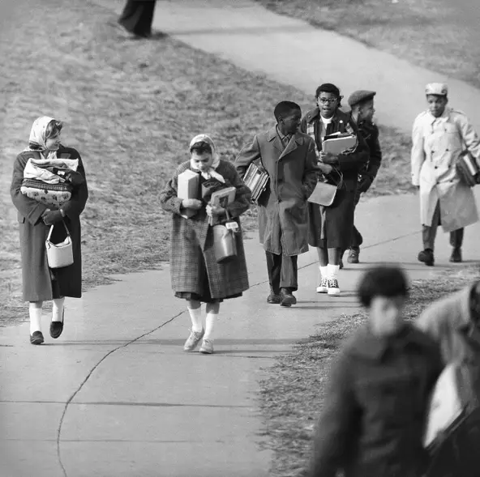
1959 – Stratford Jr. High Integrated

Slide 8
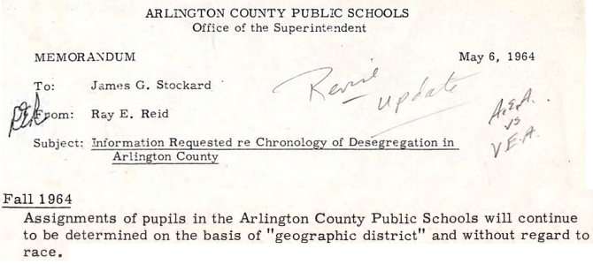
1964 – De Jure Segregation Over

Slide 9
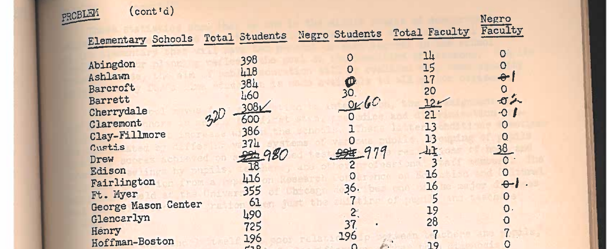
1965 – No Black Students at Abingdon

Slide 10
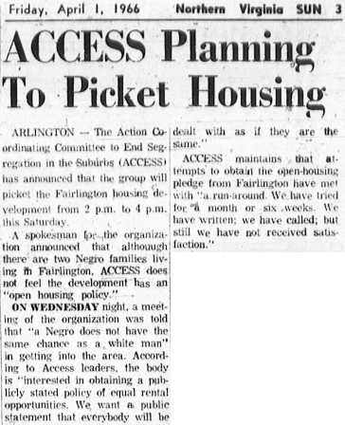
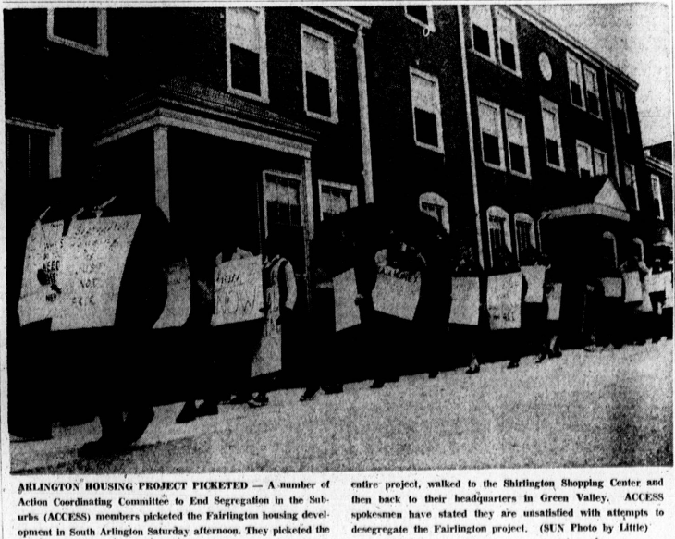
1966 – Housing Discrimination in Fairlington

Slide 11
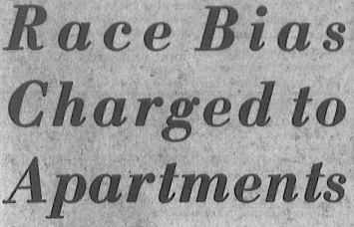
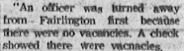
1967 – Continued Housing Discrimination

Slide 12
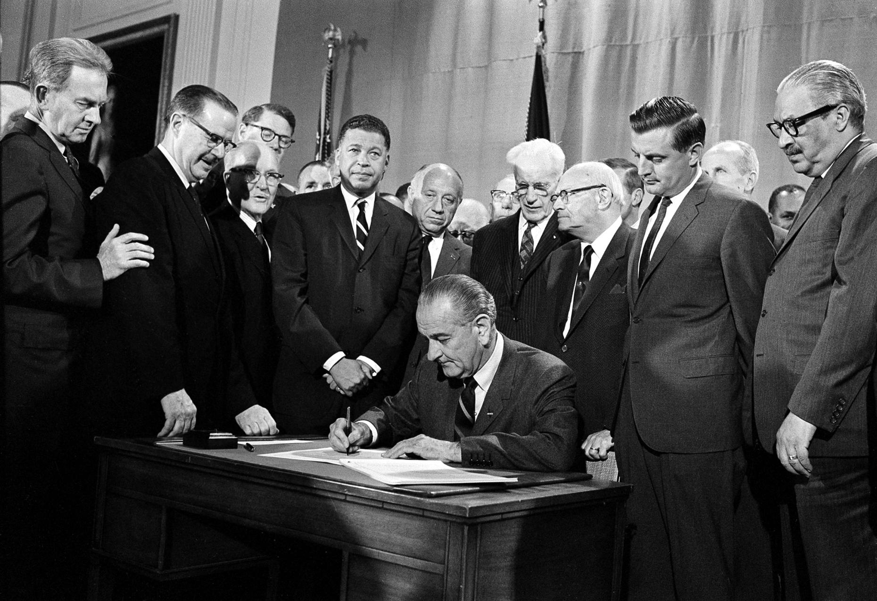
1968 – Fair Housing Act

Slide 13
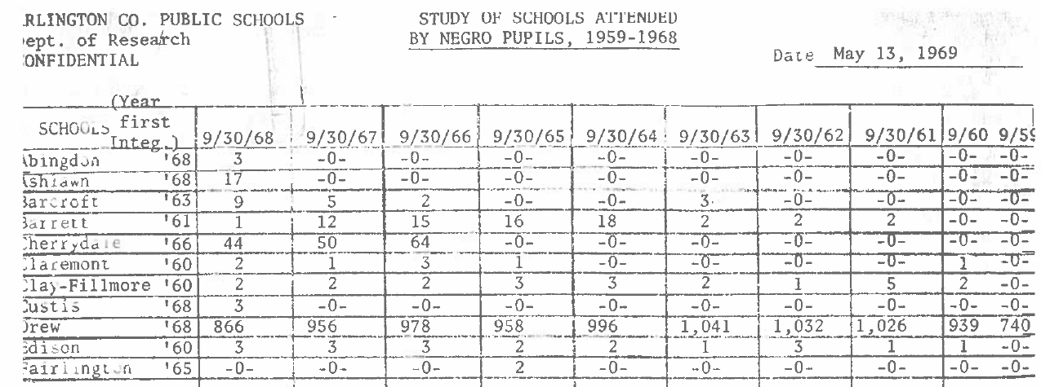
1968 – First Black Students Enroll at Abingdon

Slide 14
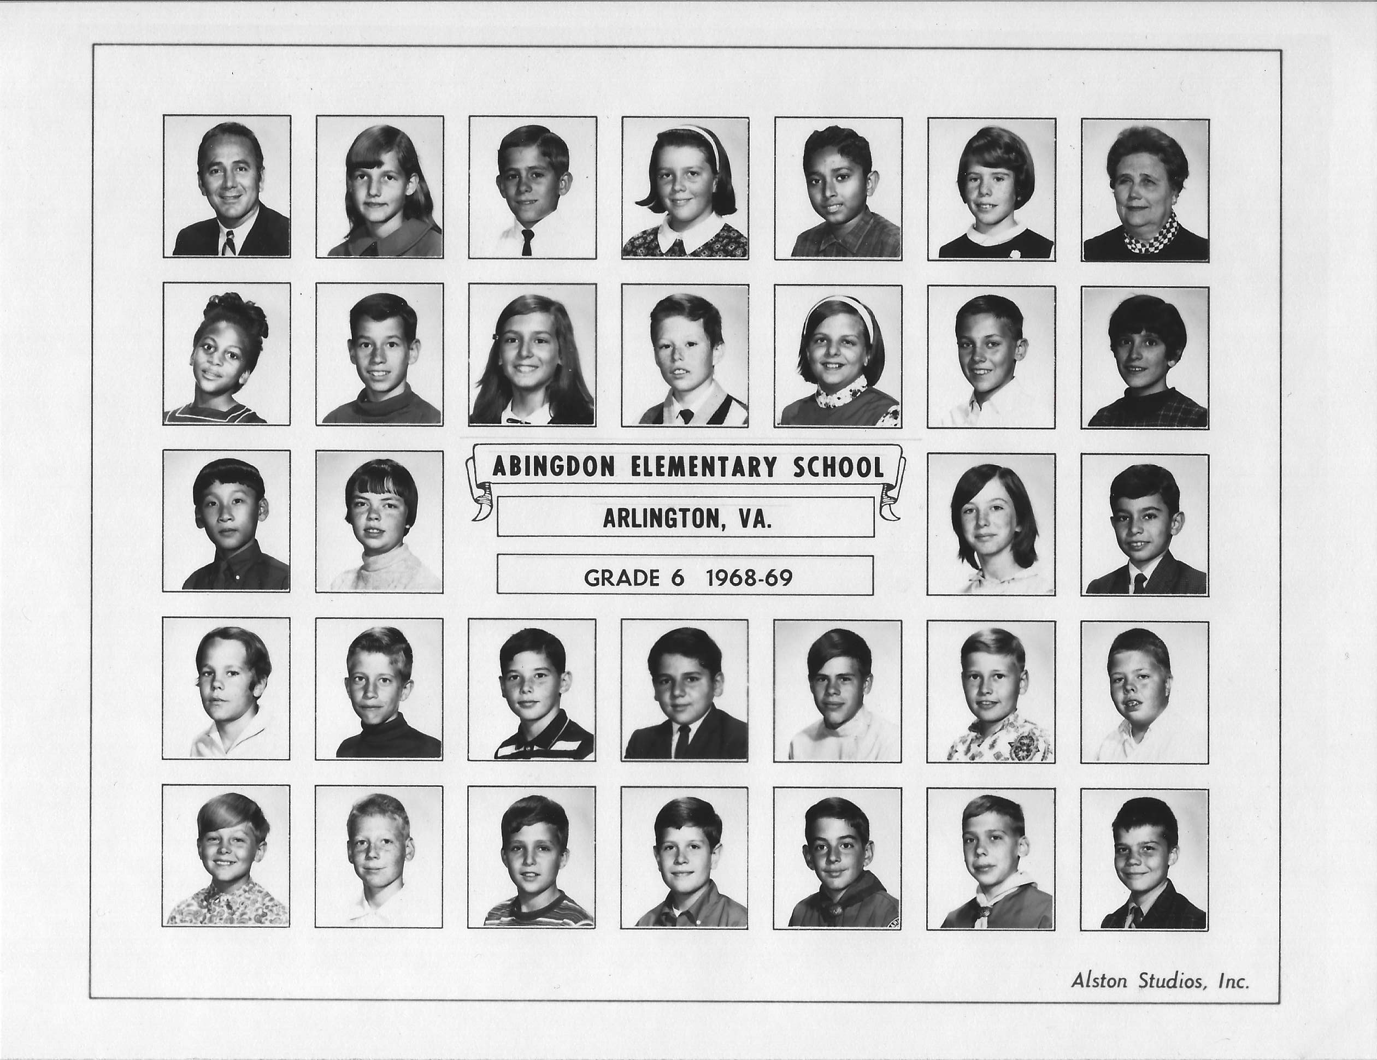
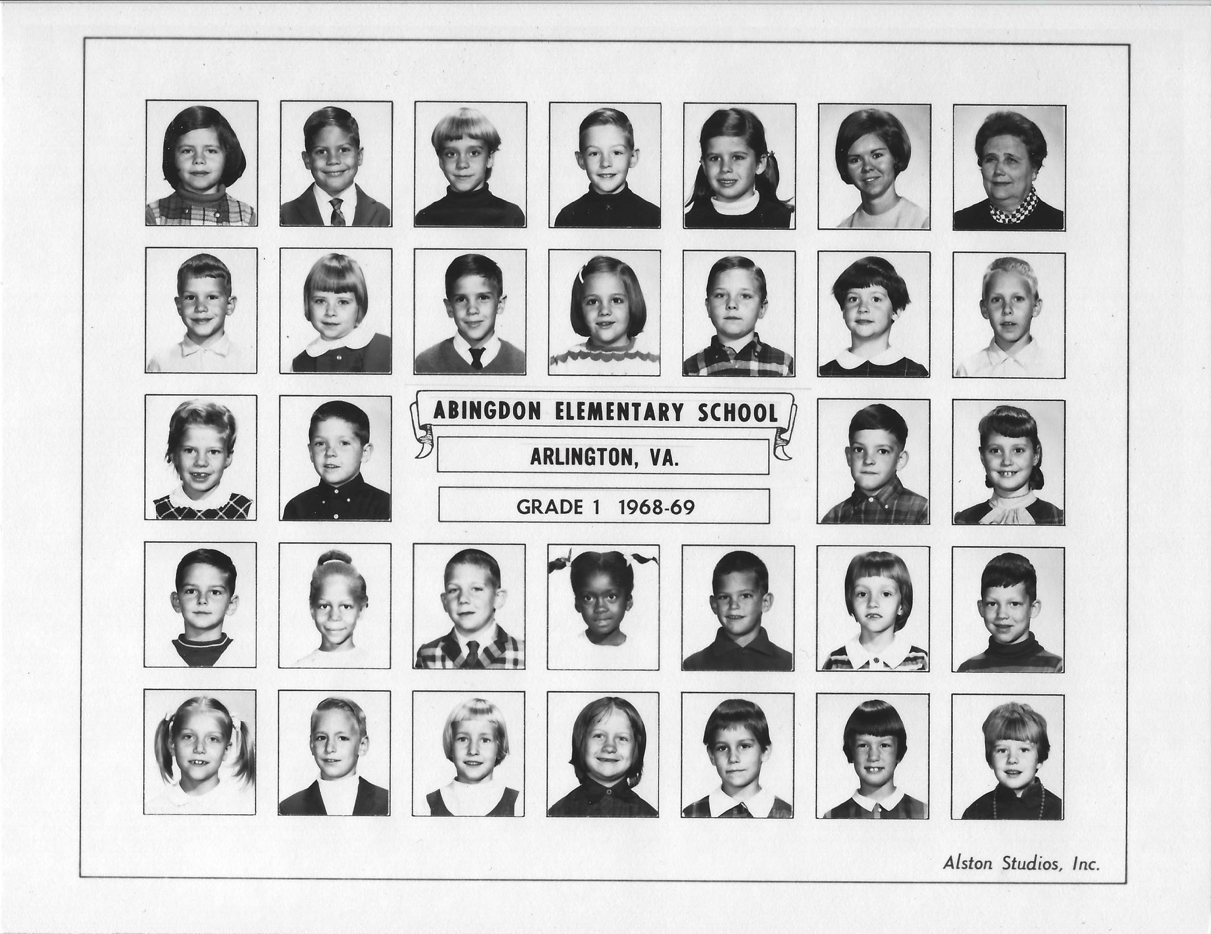
1969 – Yearbook Images

Slide 15
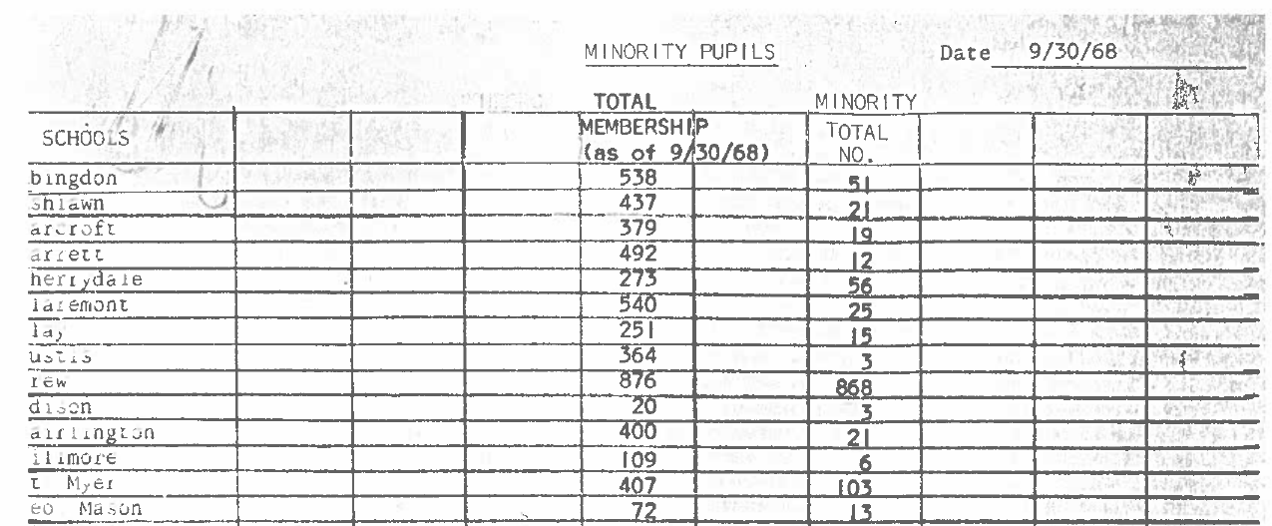
1968 – Other Races Present at Abingdon

Slide 16
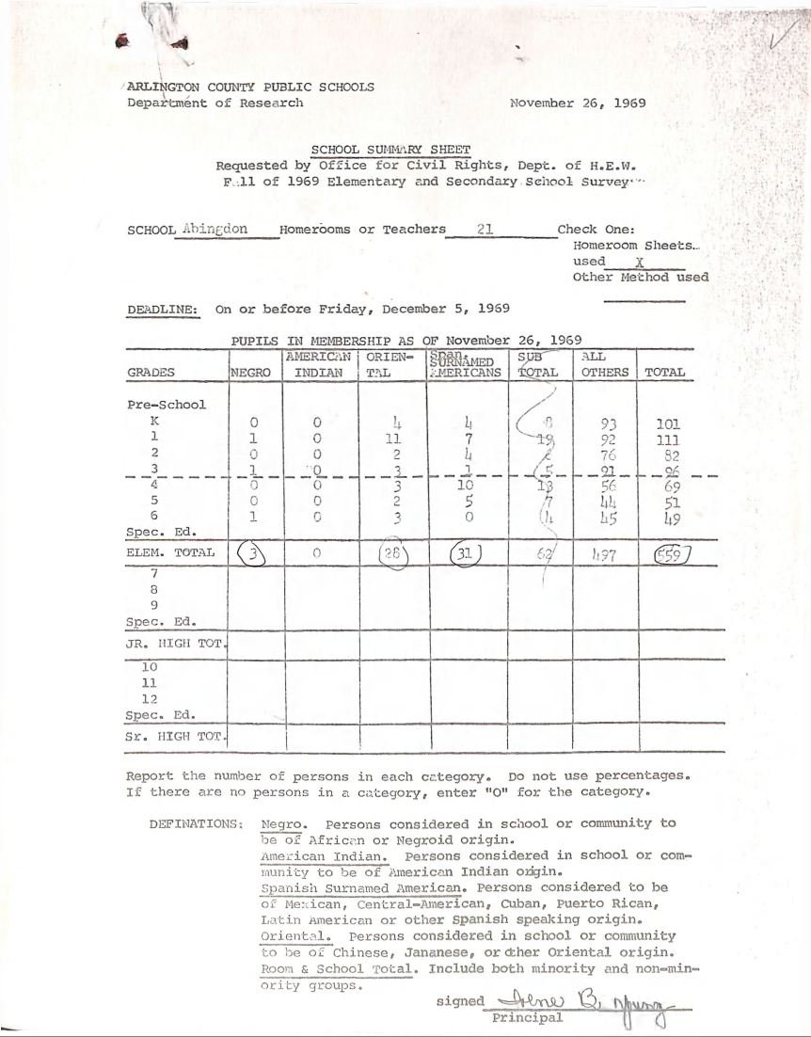
1969 – Other Races Present at Abingdon

Slide 17
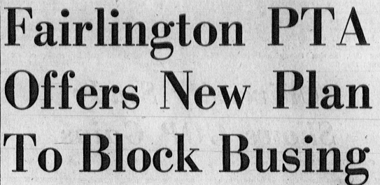
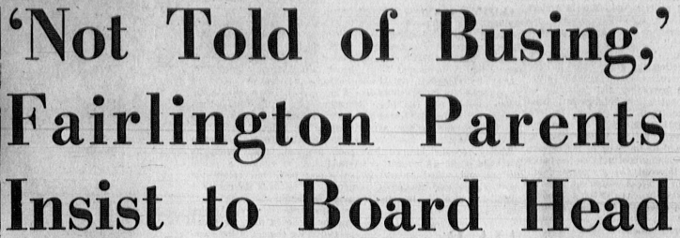
1968 – Opposition to Busing to Drew

Slide 18
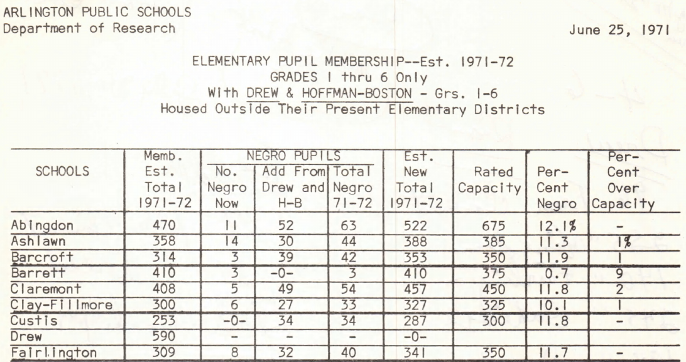
1971 – Busing From Green Valley Begins

Slide 19
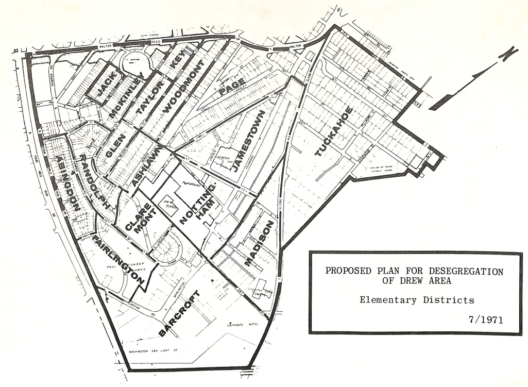
1971 – Green Valley School Boundaries

Slide 20
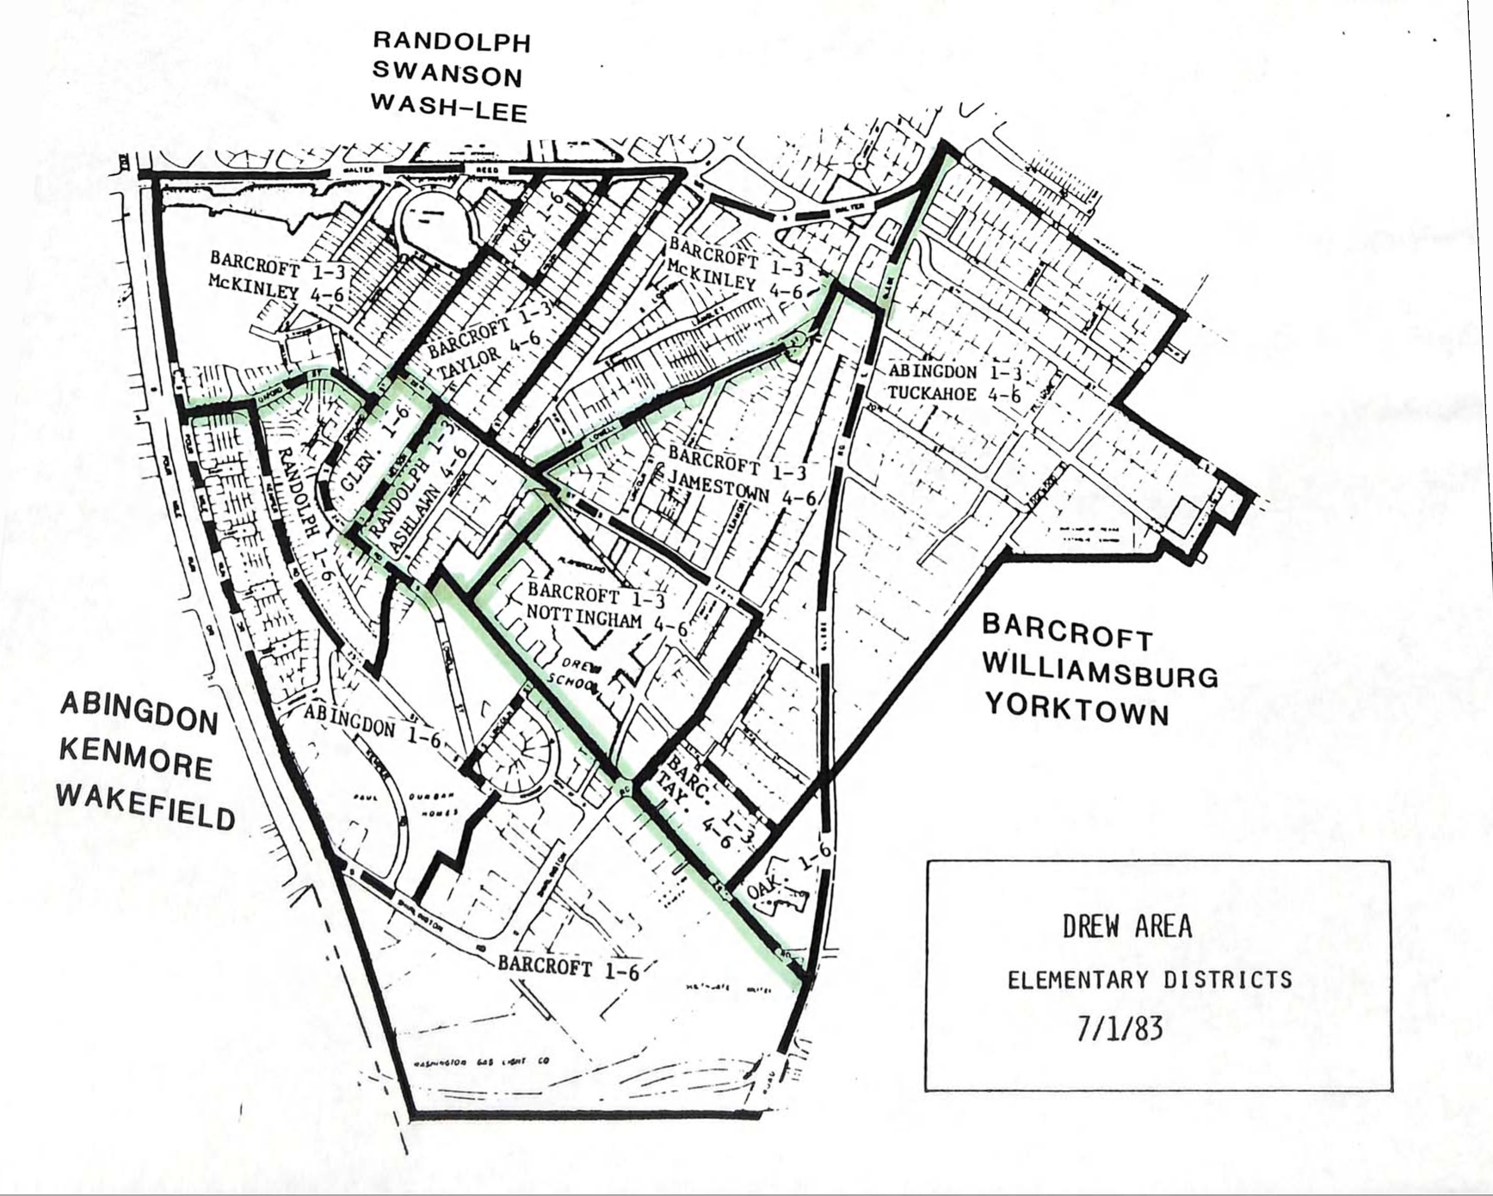
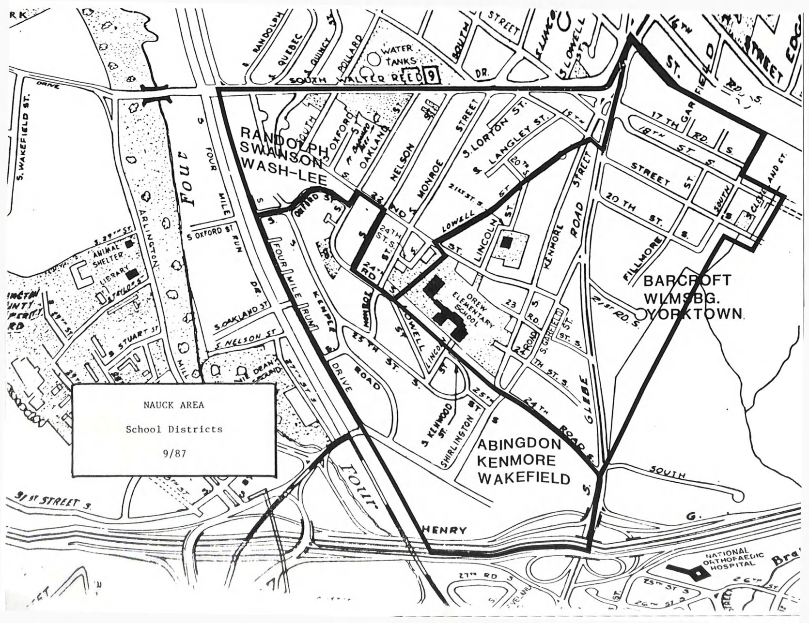
1983-1987 – Green Valley Busing Continues

Slide 21
Questions?
Visit www.abingdonpta.org/history for all of this and more.

